Slide 1

Compiler Design 1. Introduction
Instructor: Sushil Nepal, Assistant Professor
Block: 9-308
Email: sushilnepal@ku.edu.np
Contact: 9851-151617
Kathmandu University
Department of Computer Science and Engineering

Slide 2
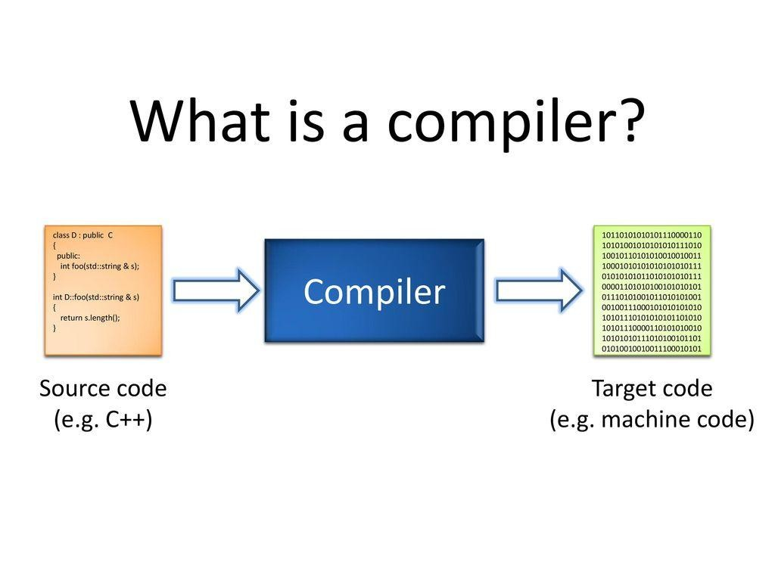

Slide 3
Compiler
A program that takes as input a program written in one language (source language) and translates it into a functionally equivalent program in another language (target language)
Source – Usually high level languages like C, C++, Java
Target – Low level languages like assembly or machine code
During translation – Also reports errors and warnings to help the programmer

Slide 4
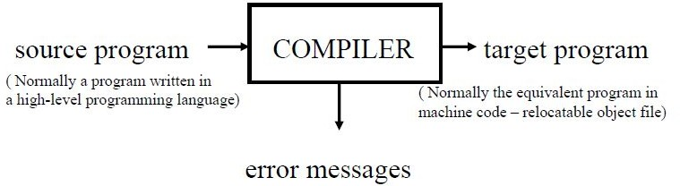

Slide 5
History of Compiler’s Development
Towards the end of 1950s, machine-independent programming languages were first proposed. Subsequently several experimental compilers were developed.
The first compiler was written by Grace Hopper, in 1952, for A-0 programming language.
The FORTRAN team led by John Backus at IBM is considered first complete compiler in 1957.
COBOL was an early language to be compiled on multiple architecture in 1960.
Early compilers were written in assembly language.
First self-hosting compiler capable of compiling its own source code in HLL was created for Lisp by Tim Hart and Mike Levin at MIT in 1962.
Since 1970’s compilers were developed for its own language such as Pascal and C.

Slide 6
Application Areas
The techniques used in compiler design can be applicable to many problems in computer science
Techniques used in a lexical analyzer can be used in text editors, information retrieval system, and pattern recognition programs
Techniques used in a parser can be used in a query processing system such as SQL

Slide 7
Application Areas
Many software having a complex front-end may need techniques used in compiler design
Eg: A symbolic equation solver which takes an equation as input. That program should parse the given input equation.
Most of the techniques used in compiler design can be used in Natural Language Processing (NLP) systems

Slide 8
Interpreter
An interpreter is another common kind of language processor
Instead of producing a target program as a translation, an interpreter appears to directly execute the operations specified in the source program on inputs supplied by the user
Both compiler and interpreters do the same job which is converting higher level programming language to machine code

Slide 9
Interpreter
Compiler transforms code written in a HLL into the machine code, at once, before program runs
Interpreter converts each HLL program statement, one by one, into the machine code, during run time
Compiled code runs faster while interpreted code runs slower
Compiler displays all errors after compilation, on the other hand, the Interpreter displays errors of each line one by one

Slide 10
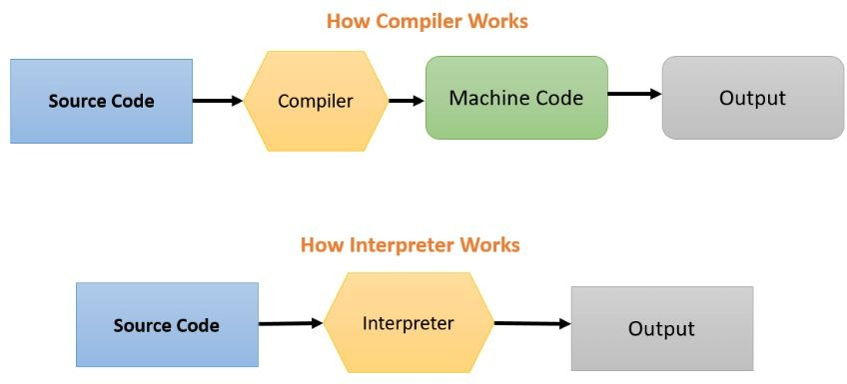

Slide 11
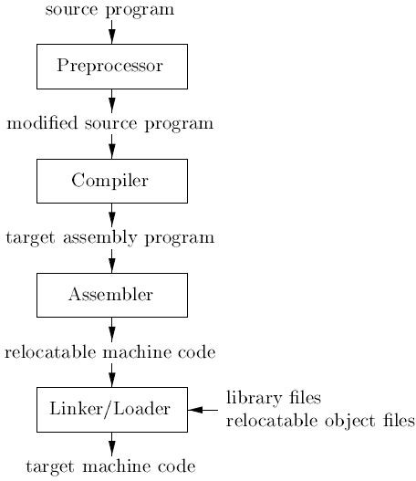
A language processing system

Slide 12
Cousins of Compiler
1. Preprocessor
Programs which translate source code into simpler or slightly lower level source code, for compilation by another compiler
Performs a pre-compilation of the source program to expand any macro definitions
A preprocessor may allow a user to define macros that are short hands for longer constructs
A preprocessor may include header files into the program context.
Eg of a macro in C:
#define square(x) ((x)*(x)) //Function like micros
#define PI 3.14 //Object like micros

Slide 13
Cousins of Compiler
2. Assembler
Programs written to automate the translation of assembly language into machine language
An assembly language is one where mnemonics are used
Mnemonics are symbols used for each machine instruction which make it easier to write/read programs compared to those written in machine language
Mnemonics are subsequently translated into machine language

Slide 14
Cousins of Compiler
3. Linker/Loader
If the target program is machine code, loaders are used to load the target code into memory for execution
Linkers are used to link target program with the libraries

Slide 15
Phases of Compilation
Two main phases of compiling process
Analysis
Synthesis
Analysis
Breaks up the source program into pieces and creates a language independent intermediate representation(IR) of program
The analysis part also collects information about the source program and stores it in a data structure called a ‘symbol table’, which is passed along with the intermediate representation to the synthesis part

Slide 16
Phases of Compilation
Synthesis
Constructs the desired target program from the intermediate representation and the information in the symbol table.
The analysis part is often called as the front end of the compiler whereas the synthesis part is called as the back end.

Slide 17
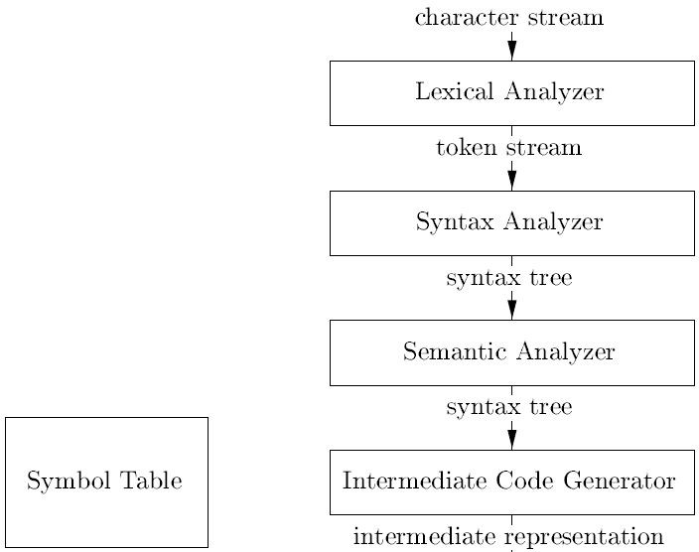
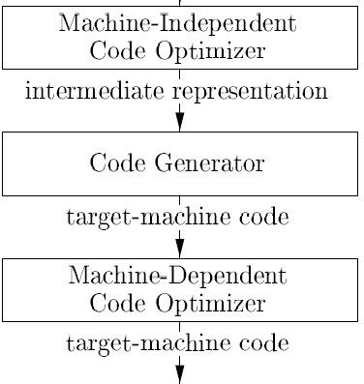
Phases of Compiler

Slide 18
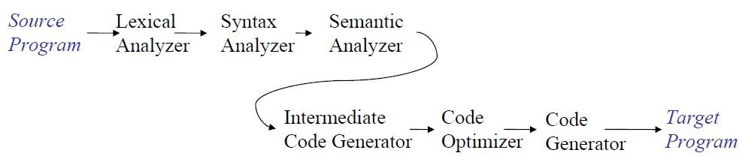
Phases of Compiler
Each phase transforms the source program from one representation into another representation
They communicate with error handlers and symbol table

Slide 19
Phases of Compiler
Analysis
Lexical Analysis
Syntax Analysis
Semantic Analysis
Synthesis
Intermediate Code Generation
Code Optimization
Code Generation

Slide 20
Lexical Analysis (Scanning)
The stream of characters making the source program is read from left to right and grouped into tokens
Tokens are sequence of characters that have a collective meaning
Examples of tokens are identifiers, reserved words, operators, special symbols, etc

Slide 21
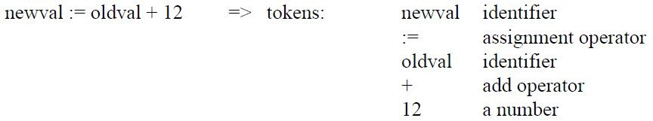
Lexical Analysis (Scanning)

Slide 22
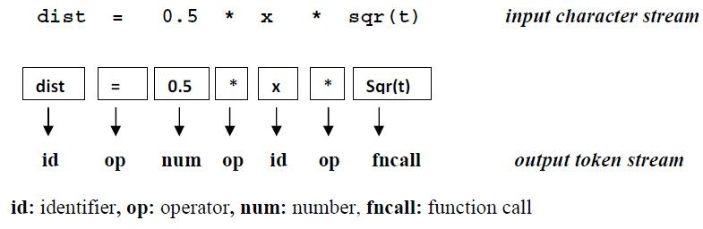
Lexical Analysis (Scanning)

Slide 23
Lexical Analysis (Scanning)
The other important task of the lexical analyzer is to build a symbol table
This is a table of all the identifiers (variable names, procedures, and constants) used in the program
When an identifier is first recognized by the analyzer, it is inserted into the symbol table, along with information about its type, where it is to be stored, and so forth
This information is used in subsequent passes of the compiler

Slide 24
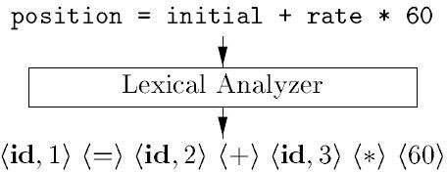
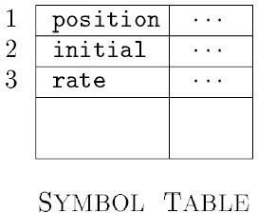
Lexical Analysis (Scanning)

Slide 25
Syntax Analysis(Parsing)
Tokens found during scanning are grouped together using context free grammar
The grammar is a set of rules that define valid structures in programming languages
Each token is associated with a specific rule and grouped accordingly
This process is called parsing
The output of this phase is parse (syntax) tree or derivation

Slide 26
Syntax Analysis (Parsing)
If the program follows the rules of the language, then it is syntactically correct
When the parser encounters a mistake, it issues a warning or error message and tries to continue
When the parser reaches the end of the token stream, it will tell the compiler that either the program is grammatically correct and compiling can continue or the program contains too many errors and compiling must be aborted
If a parse tree is reached where there are only tokens, the corresponding statements is valid.

Slide 27
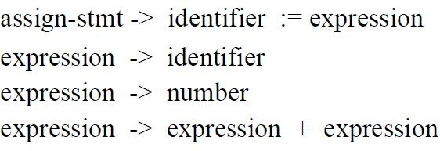
Syntax Analysis(Parsing)
Given a CFG in Backus Naur Form (BNF):

Slide 28
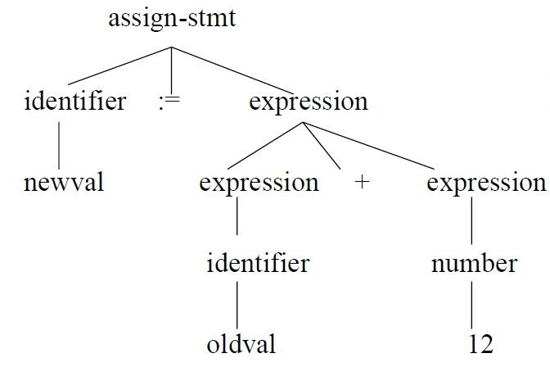
Syntax Analysis(Parsing)
Parse tree for : newval := oldval + 12

Slide 29
Syntax Analysis(Parsing)
Derivation:
assign-stmt -> identifier := expression
-> newval := expression
-> newval := expression + expression
-> newval := identifier + expression
-> newval := oldval + expression
-> newval := oldval + number
-> newval := oldval + 12

Slide 30
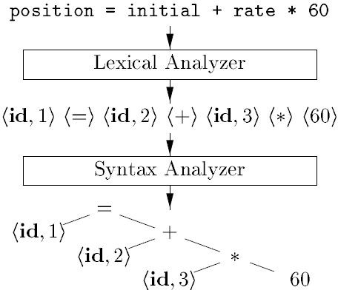
Syntax Analysis(Parsing)

Slide 31
Semantic Analysis
The parse tree or derivation is next checked for semantic errors
Semantic errors are statements that are syntactically correct but disobey the semantic rules of source language
Detection of things such as undeclared variables, functions with improper arguments, access violation, incompatible operands, etc
Type-checking is an important part of semantic analyzer
Eg: int a[9], int b, int c;
c = a * b; //Syntactically correct but semantically incorrect

Slide 32
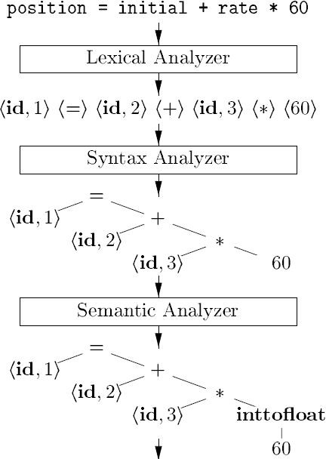

Slide 33
Intermediate Code Generation
An intermediate language is often used by many compilers for analyzing and optimizing the source program
Intermediate language should have two important properties:
It should be simple and easy to produce
It should be easy to translate target program
Intermediate codes are generally machine (architecture) independent
But the level of intermediate codes is close to the level of machine codes

Slide 34
Intermediate Code Generation
A common form used for intermediate codes is Three Address Code (TAC)
TAC looks like assembly language but does not represent a particular architecture
TAC is a sequence of simple instructions, each of which can have at most 3 operands and two operators.

Slide 35
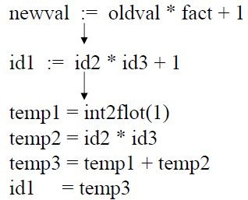
Intermediate Code Generation

Slide 36
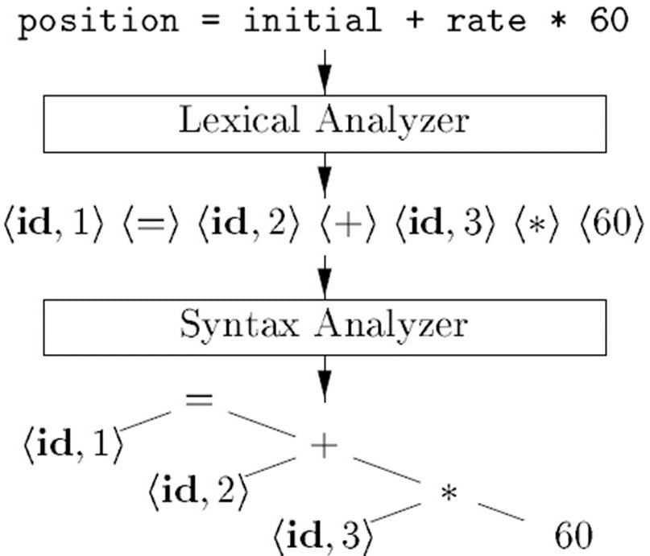
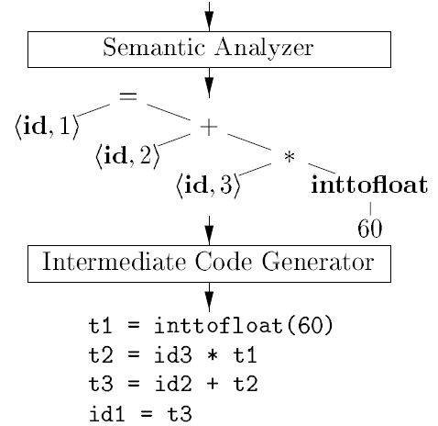
Intermediate Code Generation

Slide 37
Code Optimization
The optimizer accepts input in the intermediate representation (TAC) and outputs a streamlined version still in intermediate representation
In this phase, the compiler attempts to produce the smallest, fastest and most efficient running result by applying various techniques as:
Removing unused variables
Eliminating multiplication by 1 and addition by 0
Loop Optimization
Suppressing code generation of unreachable code segment etc.

Slide 38
Code Optimization
The optimization phase slows down the compiler
So most compilers allow this feature to be suppressed or turned off by default
Example:
t1 = b * c
t2 = t1 + 0
t3 = b * c
t4 = t2 + t3
a = t4

Slide 39
Code Optimization
Optimization:
t1 = b * c
a = t1 + t1

Slide 40
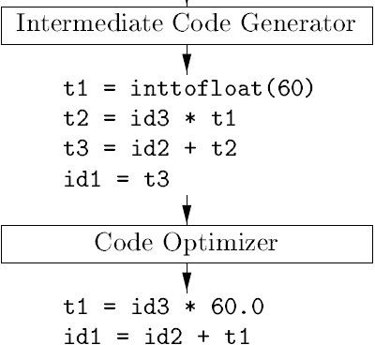
Code Optimization

Slide 41
Code Generation
This process takes the intermediate code produced by the optimizer and generates final code in target language
It is this part of the compilation phase that is machine dependent
The target code is normally is a relocatable object file containing the machine or assembly codes
The TAC is translated into a sequence of assembly or machine language instructions that perform the same task

Slide 42
Code Generation
Example (TAC):
t1 = b * c
a = t1 + t1
Corresponding assembly code (target program):
LDA R1, b
LDA R2, c
MUL R1, R2
STA t1, R1
MOV R3, t1
ADD R3, t1
MOV a, R3

Slide 43
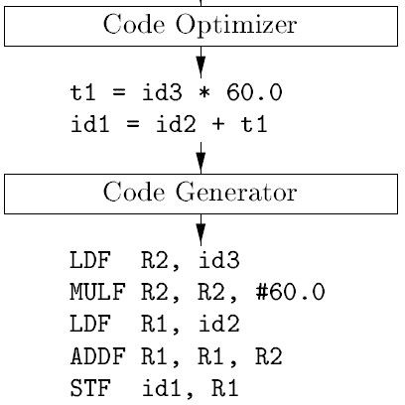
Code Generation

Slide 44
Object Code Optimization
In this phase, the object code is transferred into more efficient code by making more efficient use of processor and registers
The compiler can take advantage of machine specific idioms, specialized instructions, pipelining, branch prediction and other optimization techniques
As with intermediate code optimization, this phase of compiler is either configurable or skipped entirely

Slide 45
Object Code Optimization
Optimized version of above example:
LDA R1, b
MUL R1, c
STA t1, R1
ADD R1, t1
MOV a, R1

Slide 46
Symbol Table
A symbol table stores information about keywords and tokens found during lexical analysis
The symbol table is consulted in almost all phases of the compiler
Example:
Insert(“dist”, id)
//insert a symbol table entry associating the string “dist” with token type “id”

Slide 47
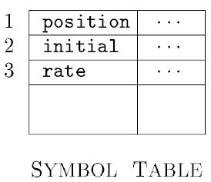
Symbol Table
Example:
Lookup(“dist”) //An occurrence of string “dist” can be looked up in the symbol table. If found, the reference to the “id” is returned else lookup returns 0.

Slide 48
Error Handling
Errors may be encountered in different phases of compiler
Objective of error handling is to go as far as possible in compilation whenever an error is encountered
Examples:
Handling missing symbols during lexical analysis by inserting symbol
Automatic type conversion during semantic analysis

Slide 49
Self Explore:
A simple one-pass compiler
One-pass/Multi-pass compiler

